Slide 1
Crop DISEASE AND SEVERITY DETECTION AND PREDICTION OF PESTICIDES
Mentor – Dr.Madhavi Sinha
ANUJ JAIN(BE/25036/14)
YASH TONGIA(BE/25030/14)

Slide 2
Introduction
Each year, plant viruses and fungal attacks lead to crop losses of up to 30 percent and moreover excess usage of pesticides leads to spreading of fatal diseases such as cancer, autism and asthma.
That is why it is important to detect plant disease in its early stages. The existing methods include naked eye observations by experts. This includes constant monitoring which is very costly and a tedious exercise for large farms.
The farmers in India are less educated to understand the vulnerability and severe consequences of the diseases. They either ignore or recklessly use pesticides to get rid of the problem. This not only leads to spreading of fatal diseases and soil contamination but is also not economically beneficial for them.
Thus it is very important for them to know the disease and their proper treatment for better crop production and environmental balance.

Slide 3
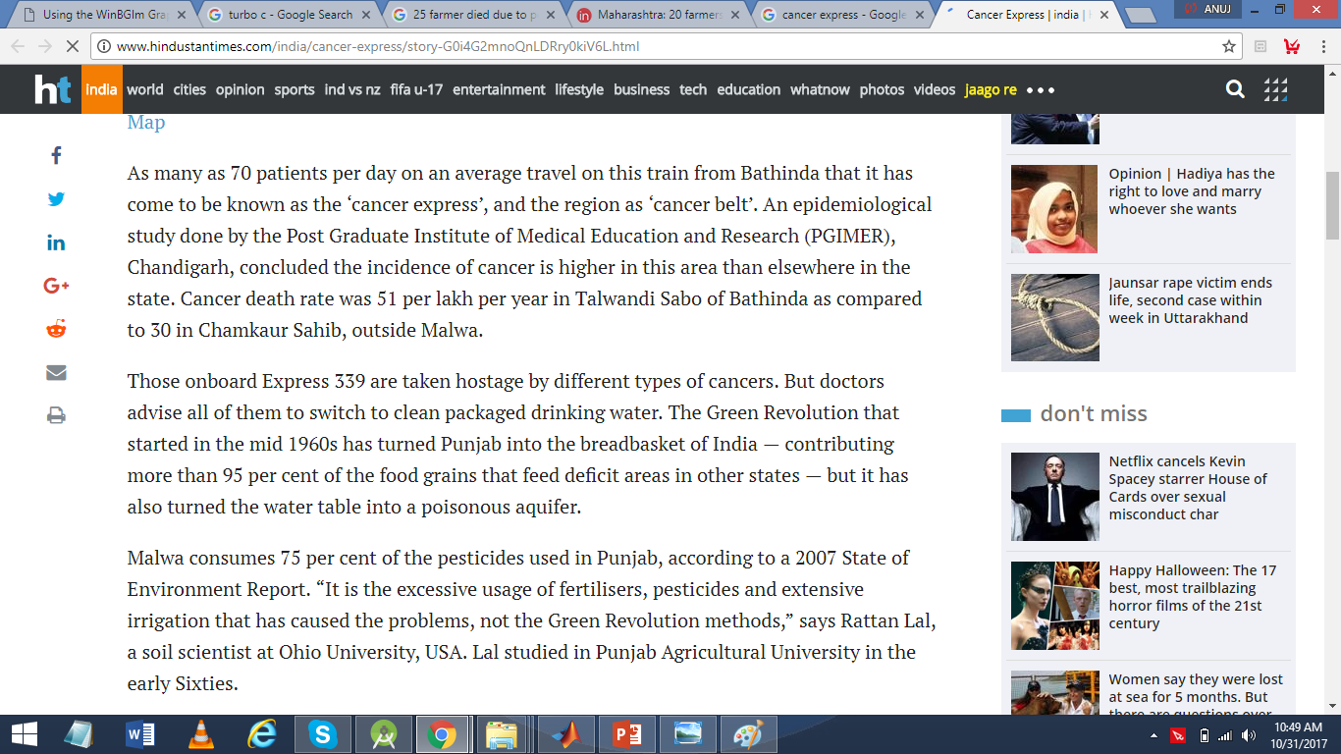
Motivation

Slide 4
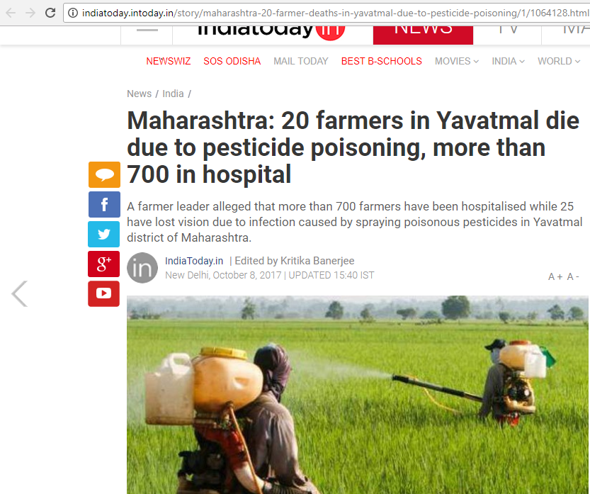

Slide 5
Objectives
The main objective of this project is to design a software tool to identify the disease with which a crop is affected using its image. The underlying objectives are explained as follows:
To apply image processing techniques to obtain affected portion of the crop and extraction of consequential feature values.
To perform comparison of extracted values with sample values to identify and classify the disease using various classifier algorithms.
To integrate and compare results of various classifier algorithms.
To predict the necessary control measures to cure the disease without any environmental and economic damage

Slide 6
Methods and Materials
The project consists of five phases which are
Image Acquisition and Preprocessing.
Obtain useful segments to classify the crop disease.
Computing the features using color co-occurence methodology.
Classification of the disease.
Prediction of the amount of pesticides.
Phase 1:
Image acquisition is the very first step that requires capturing an image with the help of a digital camera. Preprocessing of input image to improve the quality of image and to remove the undesired distortion from the image. Clipping of the leaf image is performed to get the interested image region and then image smoothing is done using the smoothing filter. To increase the contrast Image enhancement is also done. Mostly green colored pixels, in this step, are masked. In this, we computed a threshold value that is used for these pixels. Then in the following way mostly green pixels are masked: if pixel intensity of the green component is less than the pre-computed threshold value, then zero value is assigned to the red, green and blue components of the this pixel.

Slide 7
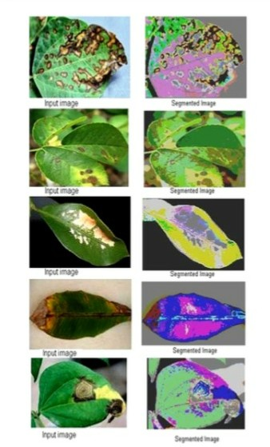

Slide 8
Methods and Materials
Phase 2:
Obtain the useful segments to classify the leaf diseases. Segment the components using genetic algorithm
For doing clustering appropriately, the search capability of Genetic Algorithms can be used, to set of unlabeled points in N-dimension into K clusters. On image data, we will apply the same idea in our proposed scheme. We have taken a color image of size m*n and every pixel has Red, Green and Blue components.
Phase 3:
Computing the features using color co-occurrence methodology.For feature extraction the method used is color co-occurrence method It is the methodology in which both the texture and color of an image are considered, to come to the unique features, which shows that image.

Slide 9
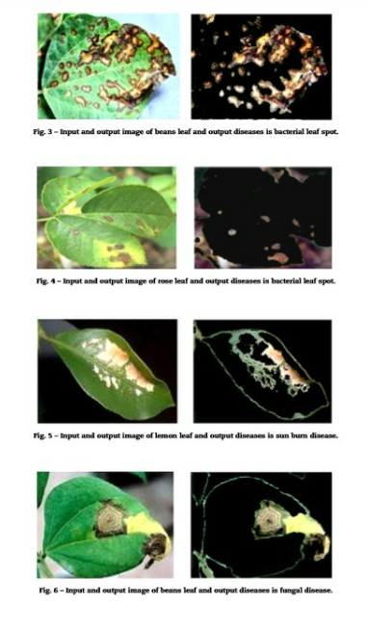

Slide 10
Methods and Materials
Phase 4:
In this phase classification, extraction and comparison of co-occurrence features for the crop leaves with the corresponding feature values stored in data set.
The following algorithms are used for the computations:
1.Naïve Bayes Method:
Naive Bayes assumes that all features in the feature vector are independent, and applies Bayes’ rule on the sentence. Naive Bayes calculates the prior probability frequency for each label in the training set. Each label is given a likelihood estimate from the contributions of all features, and the sentence is assigned the label with highest likelihood estimate.
2.Support Vector Machine (SVM):
An SVM model is a representation of the examples as points in space, mapped so that the examples of the separate categories are divided by a clear gap that is as wide as possible. New examples are then mapped into that same space and predicted to belong to a category based on which side of the gap they fall.

Slide 11
Methods and Materials
3.K-Nearest Neighbors Algorithm:
K nearest neighbors is a simple algorithm that stores all available cases and classifies new cases based on a similarity measure (e.g., distance functions).It is a non-parametric method used for classification and regression commonly used in pattern recognition.
Phase 5:
Upon the classification and severity detection,the software tool recommends the proposed measures which should be taken in order to combat the disease.

Slide 12
Expected Outcome
The software tool determines the affected region of the image and extracts the consequential values and compares them with sample data to determine and classify the disease associated with the crop and predicts the necessary control measures. Further it also compares and analyze the outcome of various classifier algorithms.

Slide 13
Structural and data diagrams

Slide 14
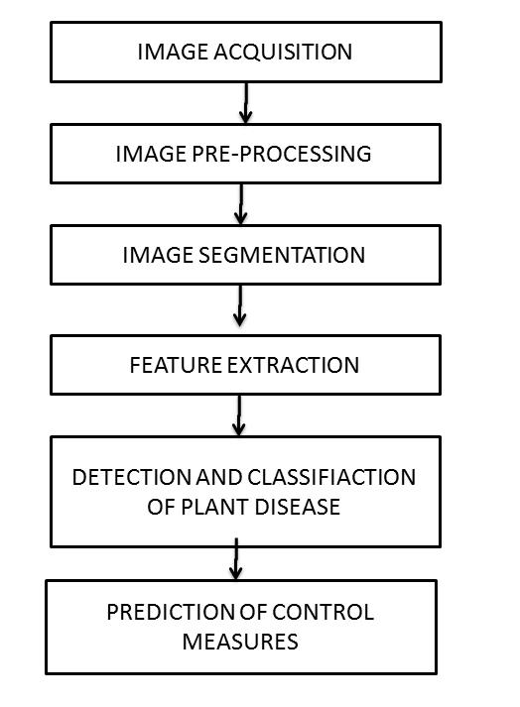

Slide 15
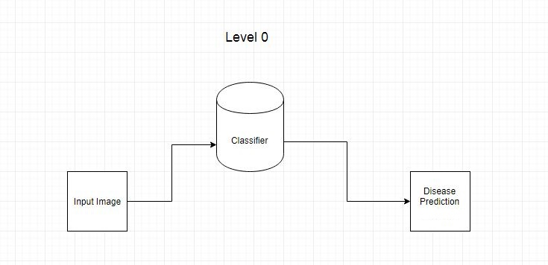
Data flow diagrams

Slide 16
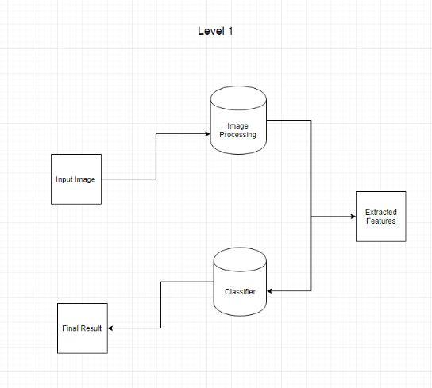

Slide 17
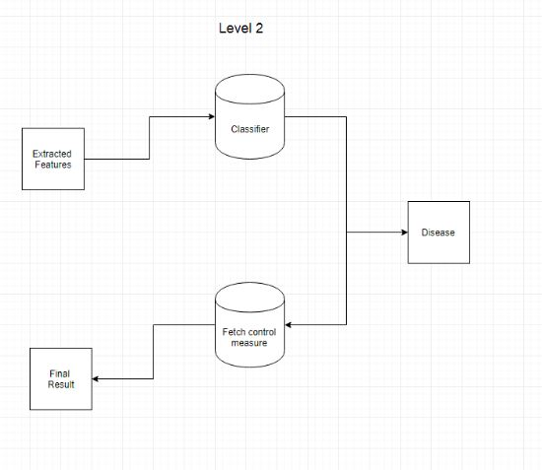

Slide 18
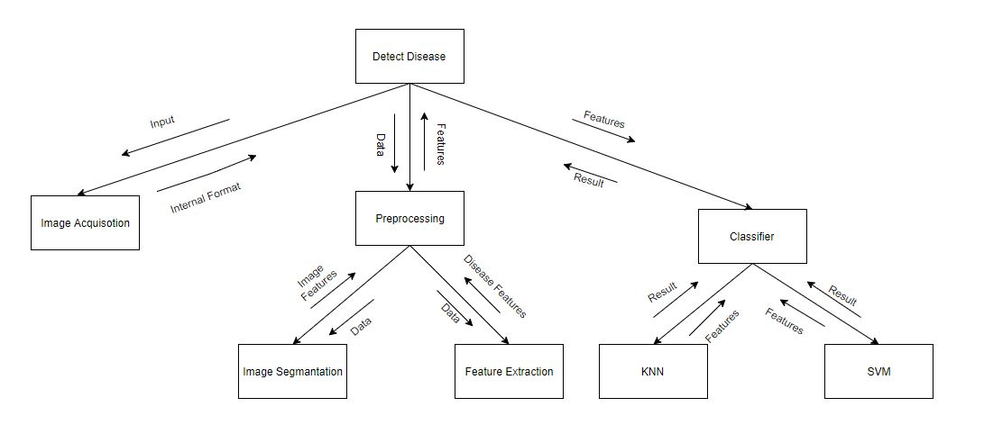
Structure chart

Slide 19
Detailed description of units

Slide 20
Image acquisition
Identificaction | Input Image
Type | Module
Input | An image in which we have to detect the disease segments.
Function | The main function of this module is to allow the user to upload the image in the system.
Output | The image provided by the user.

Slide 21
Image Pre-Processing and Segmentation
Identifiaction | Preprocessing
Type | Module
Input | The input is the image provided by the user.
Function | The main function of this module is to pre-process the given input image. A matrix will be formed in which the value of each pixel of image will be stored in form of RGB (Red, Green, Blue) value.
Dependencies | The pixel value will be dependent on the image format.
Processing | An input image will be provided by the user. The image segmentation will be performed and the image is segmented into pixels and the value of each pixel (in form of RGB) will be stored in form of matrix.
Output | The output is the matrix in which the value of each pixel will be stored.

Slide 22
Feature Extraction
Identification | Feature Extraction
Type | Module
Input | The input is the segmented image provided by the previous module which is the processed form of the image obtained from the user.
Function | The main function of this module is to extract feature of the given input image. A matrix will be formed in which the features to be judged are stored which will be compared to the pre-stored values.
Dependencies | This unit depends on the segmented image.
Processing | The image is obtained from the user is segmented and given to this unit for feature extraction. The various parameters are calculated and stored to represent the color changes and textures.
Output | The output is the matrix in which the values associated with image are stored.

Slide 23
Image Classification
Identification | Classification
Type | Module
Input | The features extracted from the segemented image.
Purpose | To obtain the disease affected.
Function | The main function of this module is apply the classification algorithms on the extracted features and use predefined dataset to detect the disease with which the plant is affected.
Resources | The dataset is required for this process.
Output | The output from this unit is the integrated output from the various classifier algorithms.

Slide 24
output
Identification | Output
Type | Module
Purpose | The purpose of this module is to provide the output which are the pesticides associated with the disease.
Processing | Depending upon the disease detected the pesticides associated and their amount is calculated according to the intensity of the disease detected.
Output | The output is pesticide type and quantity according to the disease detected.

